Slide 1
Introduction to Robotics
CSE 461
Lecture 9: Robot Navigation (Mapping and Exploration)
Niloy Irtisam
Lecturer, Dept. of Computer Science and Engineering
Brac University

Slide 2
Robots Navigation
Path Planning: How to I get to my Goal?
Localization: Where am I?
Mapping: Where have I been?
Exploration: Where haven’t I been?

Slide 3
Robots Navigation
Path Planning: How to I get to my Goal?
Localization: Where am I?
Mapping: Where have I been?
Exploration: Where haven’t I been?

Slide 4
Mapping and Exploration
Question:
You are roaming around in an unknown space, what can you learn about it?
Two parts of the problem:
Mapping: As you roam around the world, how do you build a memory of the shape of the space you have moved through?
Exploration: Given that you don’t know the shape or size of the environment,
how to make sure you covered all of it?
Both have many uses:
Returning back to home/charger after some task.
Cleaning a new room efficiently; Systematic search for survivors
Mapping a collapsed mine or building.
Mapping and Exploration are also “collections of algorithms”
We will focus on “Occupancy Grid” algorithms

Slide 5
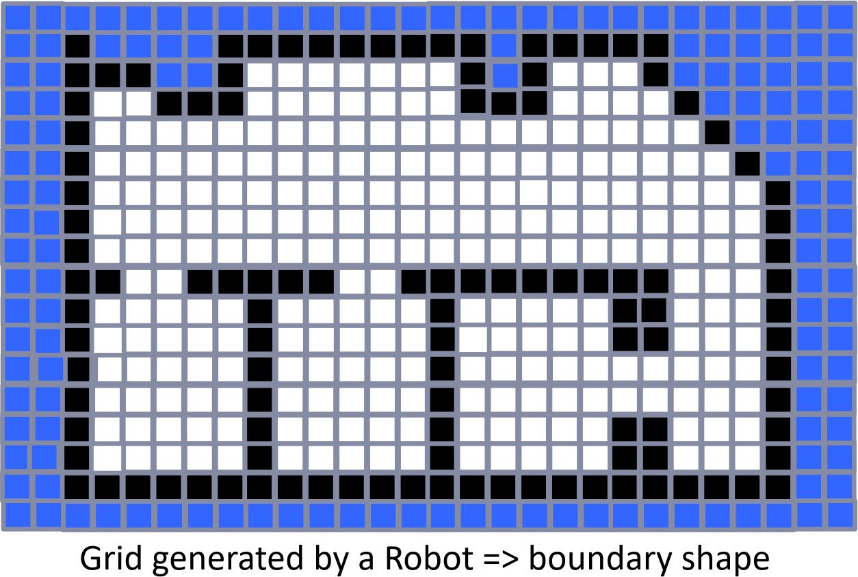

What is an Occupancy Grid?
🡽 A way of representing a map as a gridded world where each cell is either “occupied” or “empty” or
“unknown”.

Slide 6
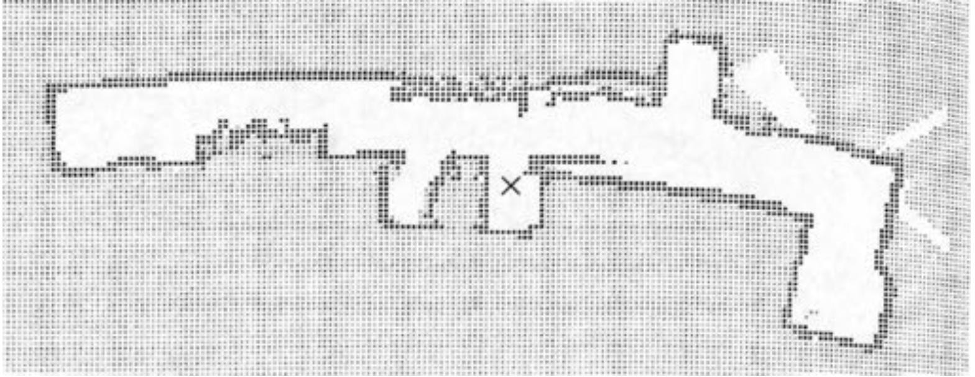
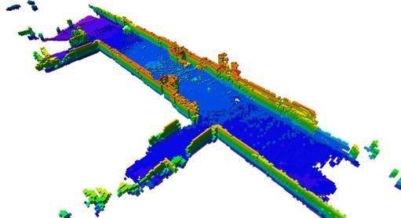
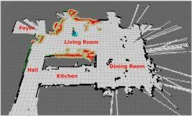
Examples

Slide 7
What is a Sensor Model?
Constructing a Sensor Model
A sensor measures raw values in an environment
You have to map that into a Grid Cell Value.
Robots can have very different sensors and configurations
Examples: LIDAR/Depth Camera
Vs. a 360 degree vision/ranging system

Slide 8
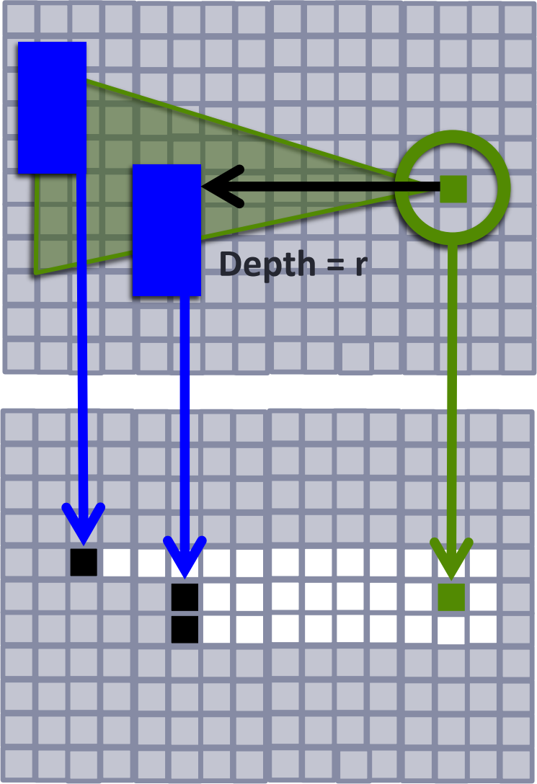
Constructing a Sensor Model
Example: Depth Sensor Model
R = maximum range, B = maximum angle
Let say the sensor at point p returns distance = “r”
Region 1 (dist < r, grid cell probably empty) Region 2 (dist = r, grid cell probably obstacle) Region 3 (dist > r, grid cell unknown/obscured)
Simplest Sensor Model
Where I stand is Empty (white)
A Better Model
Set Region 1 cells as Empty (white) Set Region 2 cells as Occupied (black).
Pick a max range/angle where data is reliable
Rest is still Unknown (gray)

Slide 9
A Simple OG Mapping Algorithm
Initialize a Grid
Set all locations as “unknown”, pick a start location and orientation
Update the Grid
Mark your current grid position as “empty”
Using your better sensor model,
Mark all visible grid locations as “empty” or “occupied”
Pick a Next Move
Look at neighboring grid positions in your map
Pick a neighboring grid location that is empty (randomly)
Move to it and update your current position in the Grid
Loop forever
Keep moving and updating the grid (unless you are “done”)

Slide 10
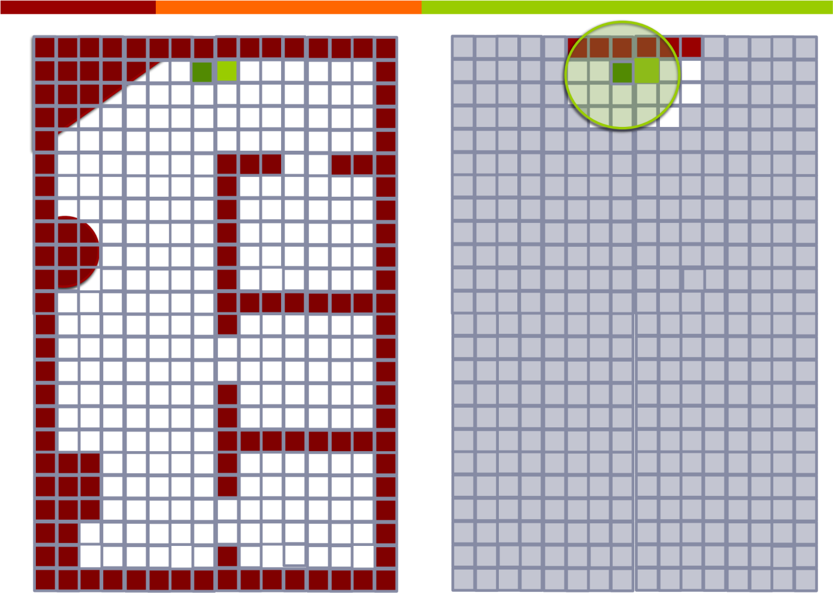

Slide 11
Exploration
Basic Concept in Robotics: Navigating a GRID Graph is different
DFS works, but will still make a robot retrace steps
Better choice: Frontier Based Exploration

Slide 12
Exploration in Grid Worlds
Frontier Based Exploration
A common technique for building maps
Key Idea:
Identify the “frontiers” between known and unknown
Frontier cell = a unknown cell with at least one empty cell
Pick a frontier cell (e.g. the closest) Plan a path to go explore it.
Done Condition:
No more frontier nodes left => your map is Complete!
If finite world, then any algorithm that systematically explores frontier nodes is guaranteed to cover the whole world.

Slide 13
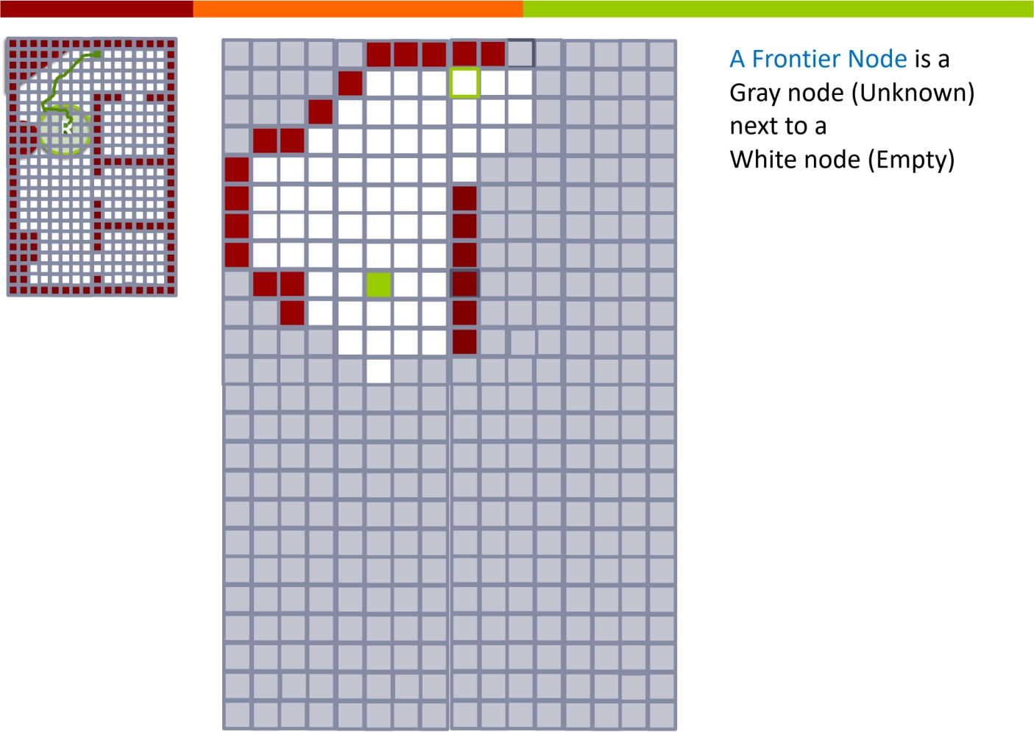

Slide 14
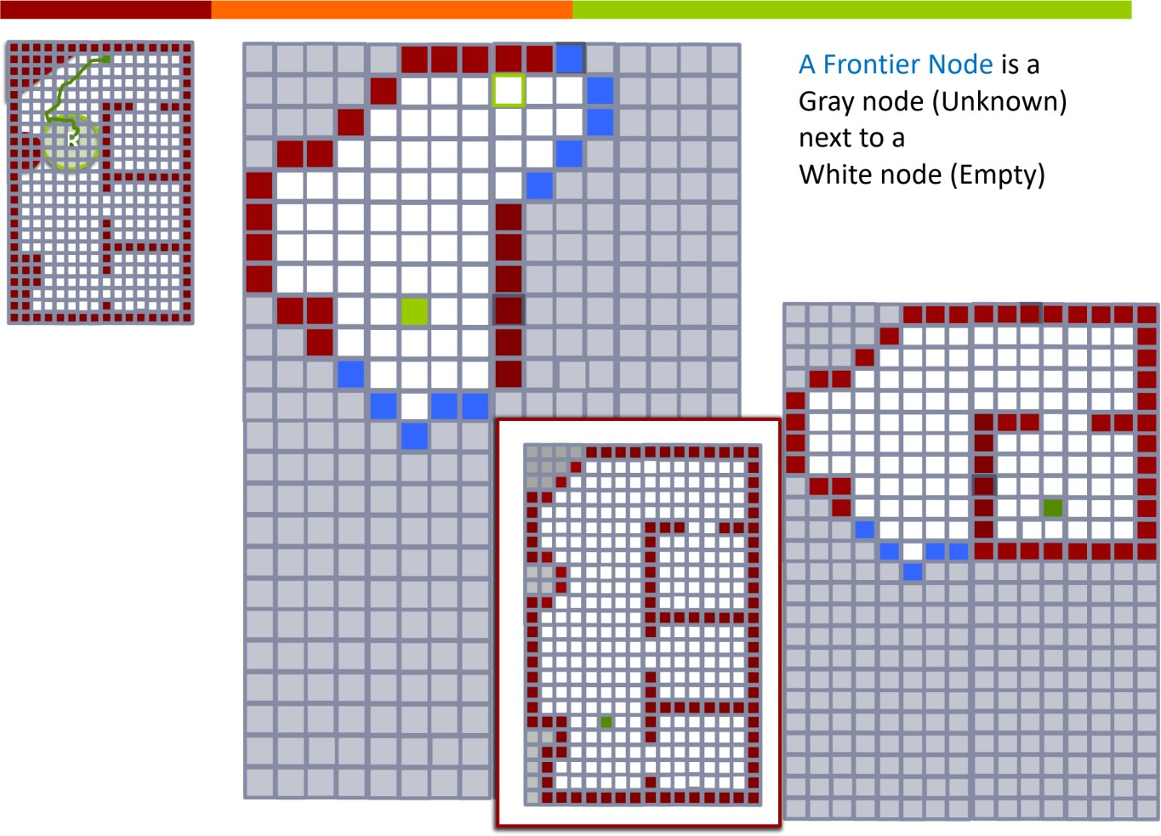

Slide 15
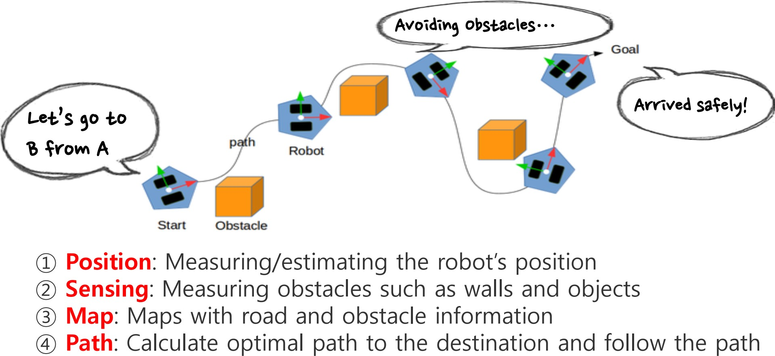
Summary

Slide 16
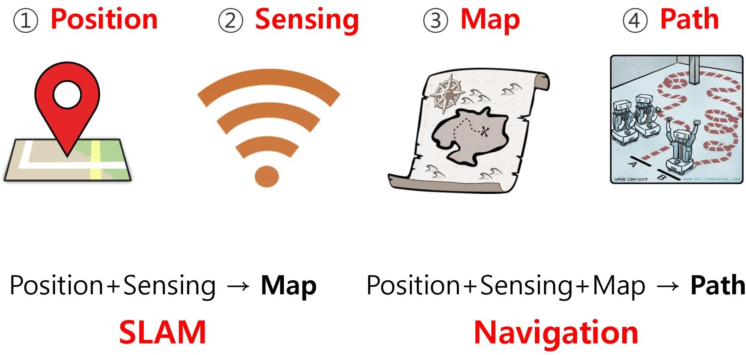
Summary
Simultaneous Localization And Mapping

